Slide 1
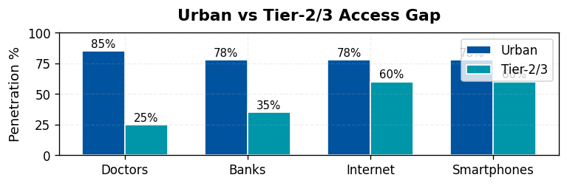
Why Tier-2 & Tier-3 India are Ripe for Disruption
Tier-2 and Tier-3 cities are the new economic frontier. With rising digital penetration but weak physical infrastructure, these markets are digitally ready yet structurally underserved.
📊 MACRO TRENDS
🚨 UNDERSERVED SECTORS
💰 45% of GDP by 2025
👥 650M Population
📱 60% Smartphone
🏥 Healthcare: 600M underserved
📚 Education: Ratio 1:60 vs 1:30
💳 12B+ UPI/month
📡 $0.17/GB Data Cost
💰 Finance: 190M unbanked
🌾 Agriculture: ₹90,000 Cr losses
Digital readiness + structural gaps = fertile ground for disruption.
Presented By — Nakul Nandanwar, Vaishnavi Bhangale, Rahul Kumbhare

Slide 2
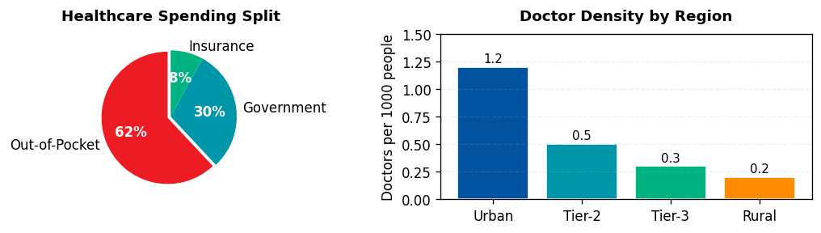
Why Healthcare is the Burning Platform
Among all underserved sectors, healthcare stands out due to its scale, urgency, and proven readiness for digital disruption.
🚫 ACCESSIBILITY
💸 AFFORDABILITY
🧠 AWARENESS & TRUST
75% doctors in urban 600M underserved Avg 50+ km travel
OOP = 62% spend 60M fall into poverty yearly from healthcare
Stigma around preventive & mental care Reliance on quacks
📊 Healthcare Market: $372B by 2025 (22% CAGR)
📊 Telemedicine: $5.4B by 2025 (45% CAGR)
📊 Diagnostics: 20% CAGR (Growing rapidly)
📊 eSanjeevani: 160M+ teleconsults (Govt success)
Healthcare = urgent problem + massive market potential.
Presented By — Nakul Nandanwar, Vaishnavi Bhangale, Rahul Kumbhare

Slide 3
Competitive Landscape & White Space
Existing players have not solved the affordability + accessibility gap in Tier-2/3 markets, leaving a white space for a vernacular, trust-based model.
Urban + Narrow
Rural + Narrow
🔍 KEY INSIGHTS
• Practo
• Local clinics
• India spends only 3% of GDP on healthcare vs 9% global avg
• Apollo 24/7
• Individual doctors
• 60% of rural Indians rely on informal practitioners
Service Breadth →
• Telemedicine adoption surged 10x post-COVID
Urban + Broad
Rural + Broad
• 1mg
• eSanjeevani
• Digital health market CAGR of 39% till 2027
• PharmEasy
🎯 WHITE SPACE
• 75% patients willing to use digital health if affordable
• Tata Health
Geography →
🎯 WHITE SPACE = Affordable vernacular model with physical touchpoints for Tier-2/3
White space = scalable, affordable healthcare model for Tier-2/3 India.
Presented By — Nakul Nandanwar, Vaishnavi Bhangale, Rahul Kumbhare

Slide 4
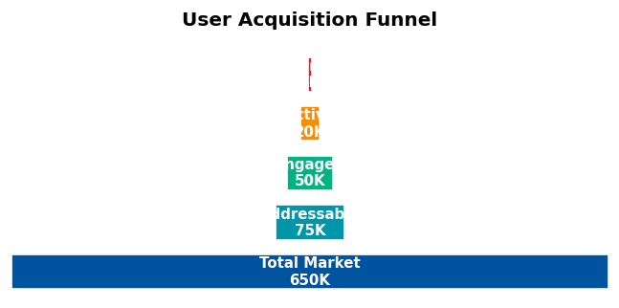
MediChain — Tech-enabled Primary Care & Diagnostics
AI Symptom Triage
IoT Diagnostic Kiosks
🤖
📊
Vernacular chatbot Triage <₹20
BP, ECG, SPO₂, sugar ~₹1L per kiosk
Blockchain Records
Phygital Linkages
🔐
🏪
NDHM aligned Secure, portable
Local pharmacies Last-mile delivery
🎯 KEY DIFFERENTIATORS
✓ Vernacular-first UX for mass adoption
✓ Affordable: <₹100 consults, ₹499/year family plan
✓ Trust via pharmacy kiosks + NGO/govt tie-ups
MediChain = vernacular, trust-first, affordable healthcare disruption.
Presented By — Nakul Nandanwar, Vaishnavi Bhangale, Rahul Kumbhare

Slide 5
Scalable Impact Pathway
MediChain balances profitability with social good, delivering both sustainable returns and healthcare access at scale.
💰 ECONOMIC IMPACT
🌍 SOCIAL IMPACT
• Subscription revenues: ₹499/year per family
• 100M+ underserved gain access by Y5
• Lower out-of-pocket burden for patients
• Preventive health adoption increases 5x
• Scalable unit economics with kiosk model
• Mental health stigma reduction
• Break-even in 18 months per district
• Women's health focus (50% users)
• 35% EBITDA margins at scale
• SDG-3 alignment: Good Health for All
📈 5-YEAR GROWTH ROADMAP
Y1
Y2
Y3
Y4
Y5
PILOT
EXPAND
SCALE
GROWTH
NATIONAL
100 kiosks 50K users 5 districts
500 kiosks 300K users 3 states
2500 kiosks 1M users 25 cities
10K kiosks 10M users 100 cities
50K kiosks 100M users Pan-India
Scalable, sustainable, socially impactful disruption for Bharat.
Presented By — Nakul Nandanwar, Vaishnavi Bhangale, Rahul Kumbhare

